Slide 1

Which region in the U.S. offers the best ROI?
Contributors: Kent Huynh, Zeyneb Damarli, and Derrick Arbiol

Slide 2
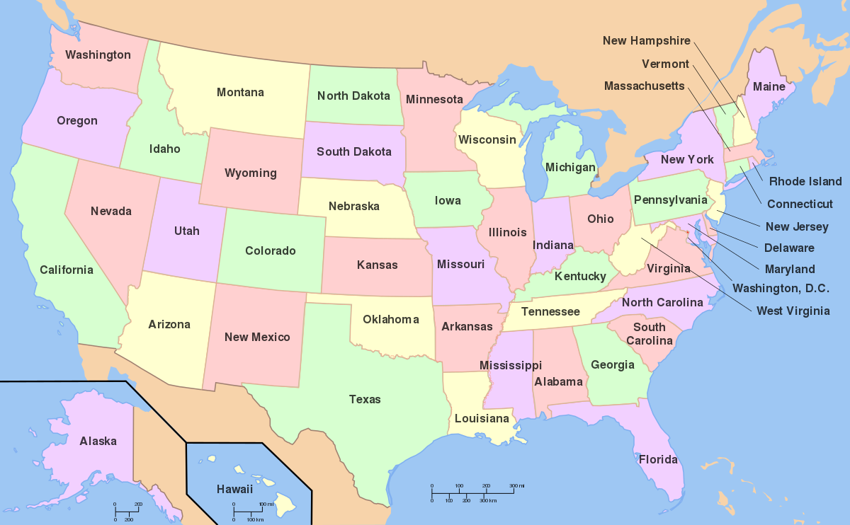
What is question we are trying to solve?
Question: Which region in the U.S. offers the most return on investment post-graduation?
List of Regions: 0-U.S. Service Schools 1-New England 2-Mid East 3-Great Lakes 4-Plains 5-Southeast 6- Southwest 7- Rocky Mountains 8-Far West 9-Outlying Areas
Notes:
Zeyneb slide

Slide 3

Introduction
API from: https://collegescorecard.ed.gov/data/documentation/
Core message:
When choosing colleges one should not make a decision on prestige alone.
One of the most common reasons students cite in choosing to go to prestigious colleges is the expansion of employment opportunities after school. For this reason, we designed our project by using tuitions and after-school earnings data of graduate students.
Scope:
Overviewed 2100 colleges in 10 regions
Reduced data to 1771
Got rid of the n/a values and remove two regions which cover the military and the islands
Parameters :
Tuition (in state), earnings 6 years, earning 10 years
Generated earnings cost ratio, earnings growth ratio, tiered earning cost ratio, worth it ratio (RoI)
Intended Audience:
People looking for college and their family members
Summary of findings:
At the end of our analysis earning cost ratio and earning growths ratio were greatest in Region 8.
Notes:
Zeyneb slide

Slide 4
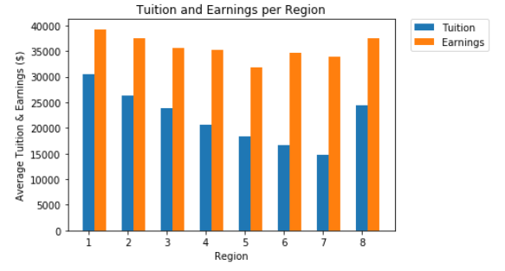
Initial Findings
Explain the data:
To provide a sense for the debt burden of attending college and the loan performance metrics for each region, we overviewed tuition-earning ratios per region.
These ratios can provide useful information for students about borrowing for college after they leave the school.
What does it show?
Tuition and Earnings
What does it mean?
In general you pay premium on tuition and you are expected to earn it back after you graduate. Our analysis shows expensive tuition generates greater returns post graduation
From the graph which region offers the best schools?
The graph shows Region 1, 8, and 2 offers highest earnings.. But the region 7 has the best RoI.
Can we use this answer our question?
No, because the this data doesn’t look at affordability and earnings growth.
Notes:
Zeyneb slide

Slide 5
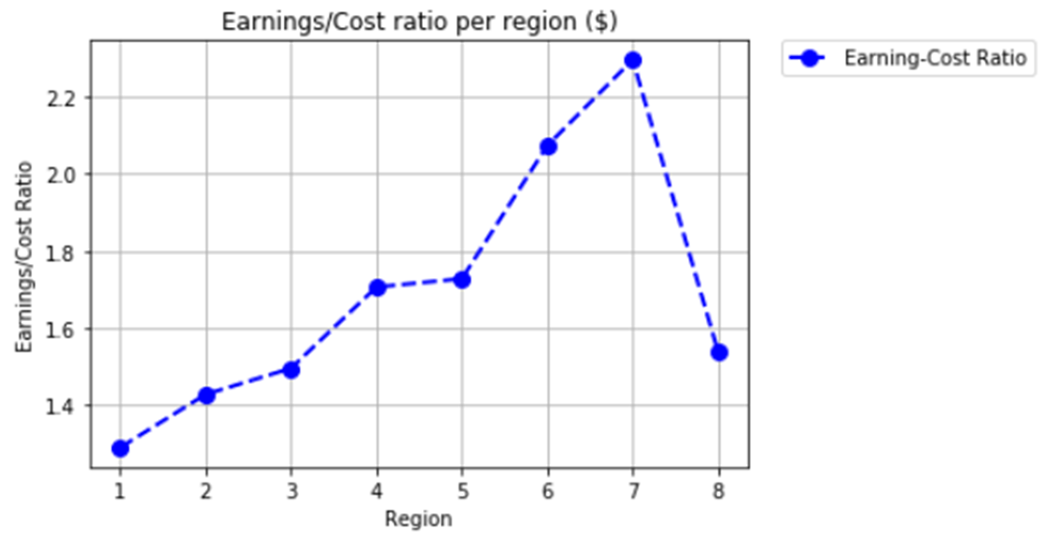
Initial Findings
How is this plot different from the last one?
Ratio: Earnings/Tuiton
This graph shows if tuition is lower than earnings you will have a greater earning cost ratio.
It shows the relationship between earning and cost better than first graph.
Region 7 has the best RoI in this graph. (2.3)

Slide 6

Another look at the data…
Goal: create a metric that includes earnings, tuition, and earnings growth (best return on investment)
Dubbed the metric as the “worth-it?” ratio
Our “second look” analysis:
Earnings&Binned Tuition
Earnings growth

Slide 7
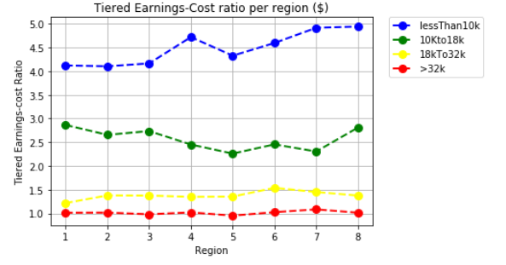
Another look at Earnings-Cost per region
We wanted to capture earning-cost ratios for different levels of tuition
Binning based on tuition tiers
Used percentiles: 25th, 50th, 75th and 100th
Bins based on percentiles:
<$10,000
$10,000 to $18,000
$18,000 to $32,000
>$32,000
Why is this important?
Notes:
This graph illustrate the (earnings/cost) ratio amongst the 4 tiers used.
This is important because some regions such may have more Ivy league/Private schools which can skew earnings/ cost ratios
Plus wanted to see if the cost of a college actually contributes to the earnings afterwards
Region 5 has 3x the number of schools of other regions

Slide 8
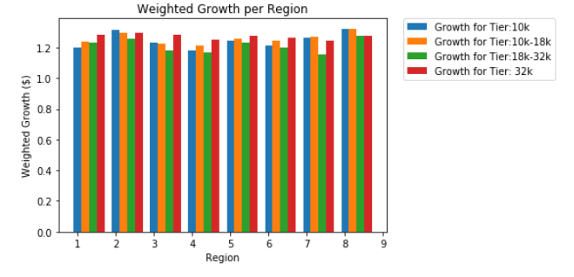

Earnings Growth
In theory, when you work at job long enough you get a raise
Raise = more $$$ = = ☺
This ratio looks at earnings 6 years after entry and 10 years of entry
Significance: to not only look at earnings, but also potential growth in income
From the graph

Slide 9
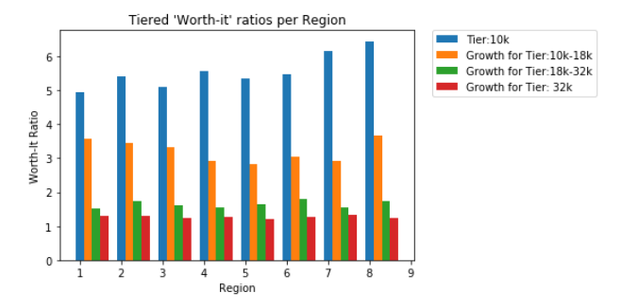
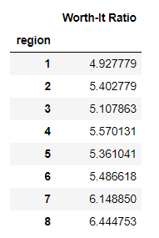
Worth it?
Tuition that is less than or equal to 10k offers the best worth-it ratios
Region 8 has the greatest ratio at 6.44
This means region 8 at price point 10k or less offers the best earnings per tuition and the best earnings growth

Slide 10

What our data didn’t account for.
We didn't look at degrees offered
We dropped 2 regions and schools that were missing data
We didn't add a weight for the number of schools per region, regions differ in number
Only looks at region not by state
We only looked at in-state tuition

